Slide 1
Brief Review of Topics Related to Artificial Intelligence
Science Club
Jack Yurasek
October 17, 2023

Slide 3
Agenda
Introduction
Definition
History
Turing Machine-Communications (Telegraph, Telephone)
Capacity vs. Speed
Measurement of Information (Uncertainty-Shannon’s Entropy)
Neural Networks

Slide 5
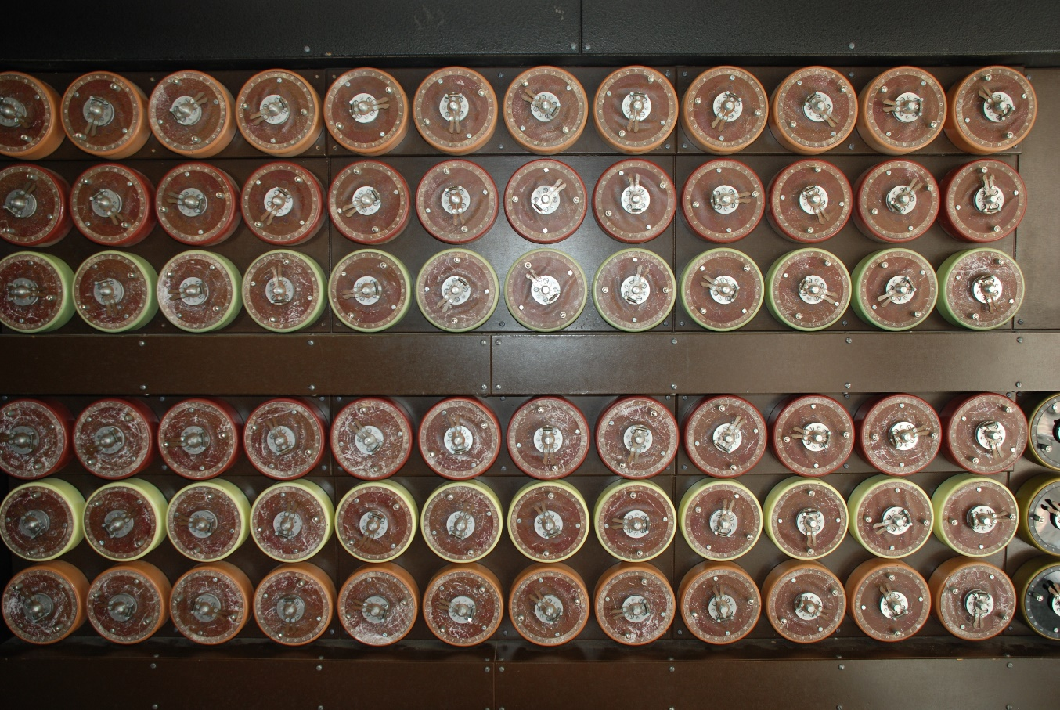

Slide 6
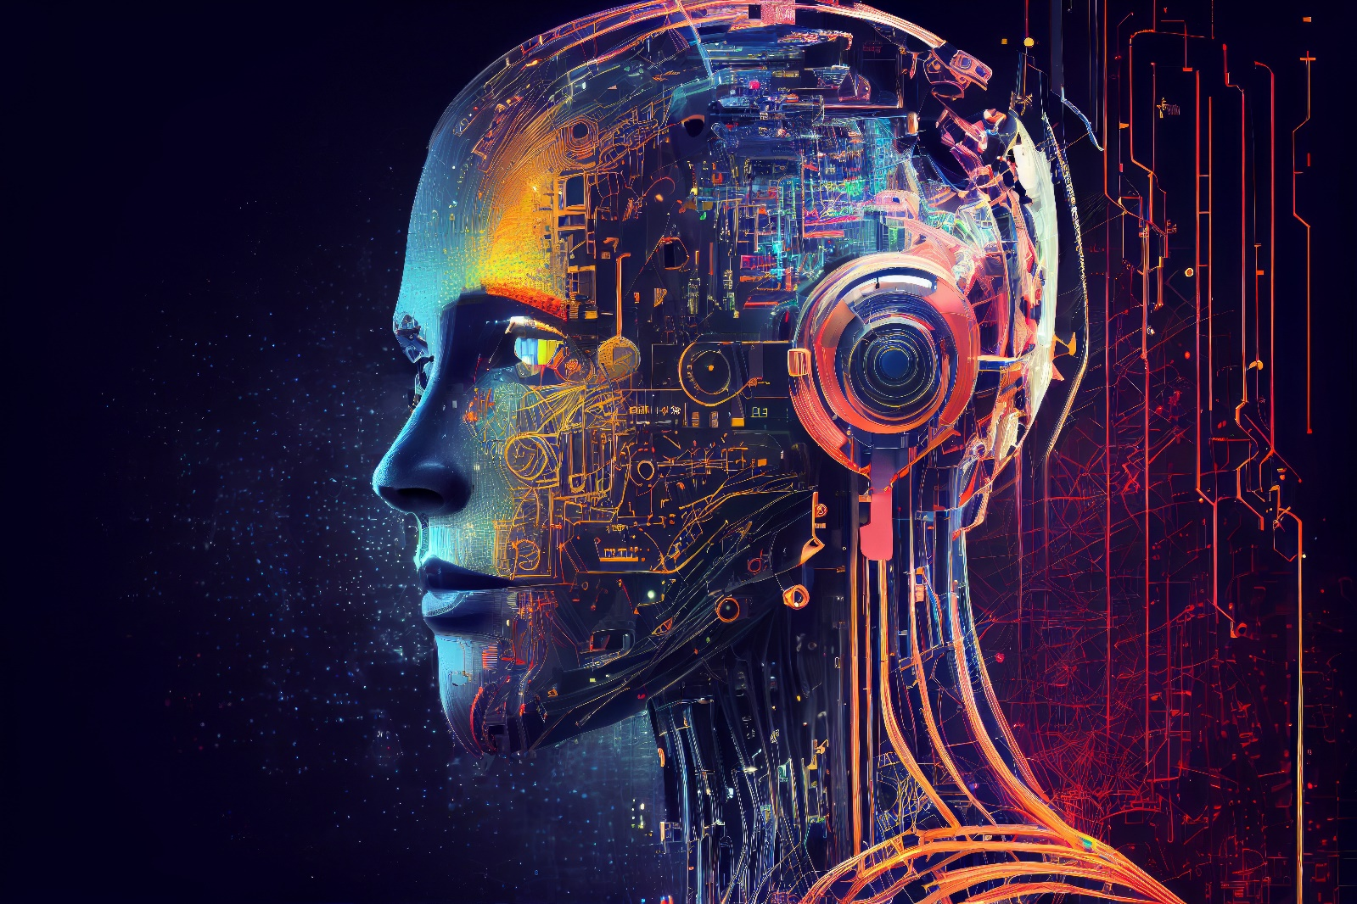
Capacity vs. Speed Measurement of Information

Slide 7
Brief Review of Topics Related to Artificial Intelligence
Introduction-
interest to essentially all members of society
possibility to reduce tedious and debilitating activities,
threat to eliminate many opportunities of employment
permitting very personal information to be exposed.
Definition -Ability of a digital computer or computer controlled robot to perform tasks commonly associated with intelligent beings. Most Simple Examples :Telephone Answering Machine, Cruise Control, Bank ATM, Spell Check
Computers- can be programmed to carry out very complex tasks- discovering proofs for mathematical theorems, playing chess etc.
Programs can not yet match human flexibility in general knowledge- Generative AI (Chatbot++) seem to be getting close.

Slide 8
Brief Review of Topics Related to Artificial Intelligence - History
In the 1930s
Allen Turing envisioned a universal machine that could include the basic characteristics of any digital computer.
established a Test to determine if it could approach human capabilities
His basic approach was to have the unit located behind a blind, with a human asking questions- when the human could not determine the difference between a human or the machine, the test was passed.
Passing the Turing Test as always been a goal, and some ‘experts’ now think it as been achieved.
In the 1940’s
Bell Labs was trying to ‘Quantify’ the, capability of its systems (the Signal-to-Noise (S/N) Ratio) and Bandwidth requirements for telephone (audio), and the maximum transmission (keying) speed possible for digital (Telegraph) messages.
Bell scientists, Hartly and Nyquist, had determined the mathematical basis for Information Theory.
Claude Shannon determined the actual amount of ‘information’ in messages based on the frequency of each letter and its probability of occurrence in words, versus all other letters.

Slide 9
Uncertainty-Shannon’s Entropy Neural Networks

Slide 10
Brief Review of Topics Related to Artificial Intelligence- History - Continued
1950s to 1970s.
The term ‘Artificial Intelligence’ was coined in 1956 – it is important today because of increased data volumes to be analyzed, advanced algorithms, and massive improvements in computing speed and memory.
1960s,
DARPA (Government research funding) began encouraging work in mimicking basic human reasoning and produced Digital assistants (today’s SIRIs etc.).
1980s to 2010s
Machine Learning—automates analytic model building from Neural Networks, statics, operations research, and physics to find hidden insights in data without explicitly being programmed as to where to look or what to conclude.
An Artificial Neural Network (NN) is a computational model of the biological Neural Network in the human brain.
The brain contains 10^14 to 15 Synapses (see photo).
The Neuron is the basic building block. It receives inputs on the ‘axon terminals’ from upstream Neural Networks. via Dendrites (the short branch of extensions from the previous Cell). They scale or ‘weight’ the signals to each input to the Cell Body, where they are processed.
The inputs are summed, a Bias is added, and an ’Activation Function’ is applied.
The Weighting of each input is based upon the importance of the signals relative to one another. The Activation Function performs various processing functions. It will generate an output signal when the signal sum exceeds a Threshold, but it can delay the output, and ‘shape’ the response (a step or a gradual sloped response).
The processed output of one stage of the Neural Network is then coupled to the next level of NN, as the process continues without human intervention.. Artificial Neural Networks can include a ‘Perception’ function which employs a learning algorithm to improve future decisions.

Slide 12
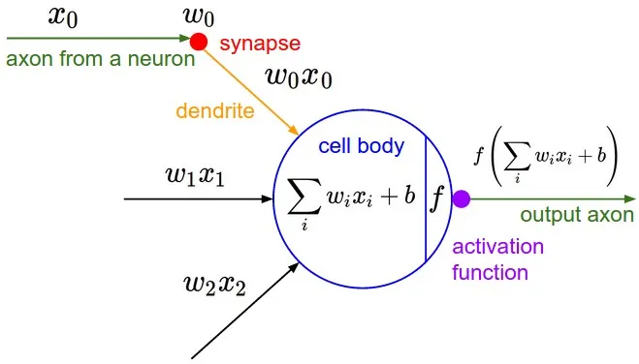
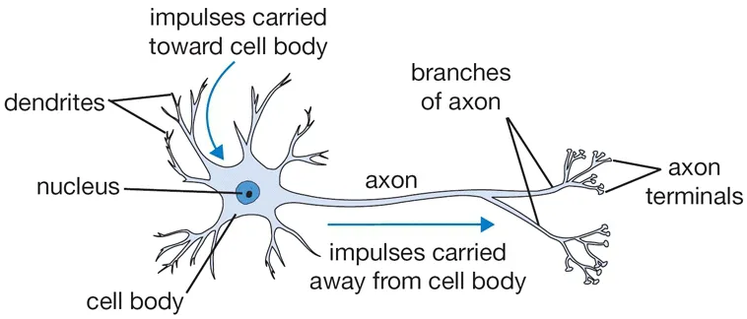

Slide 13
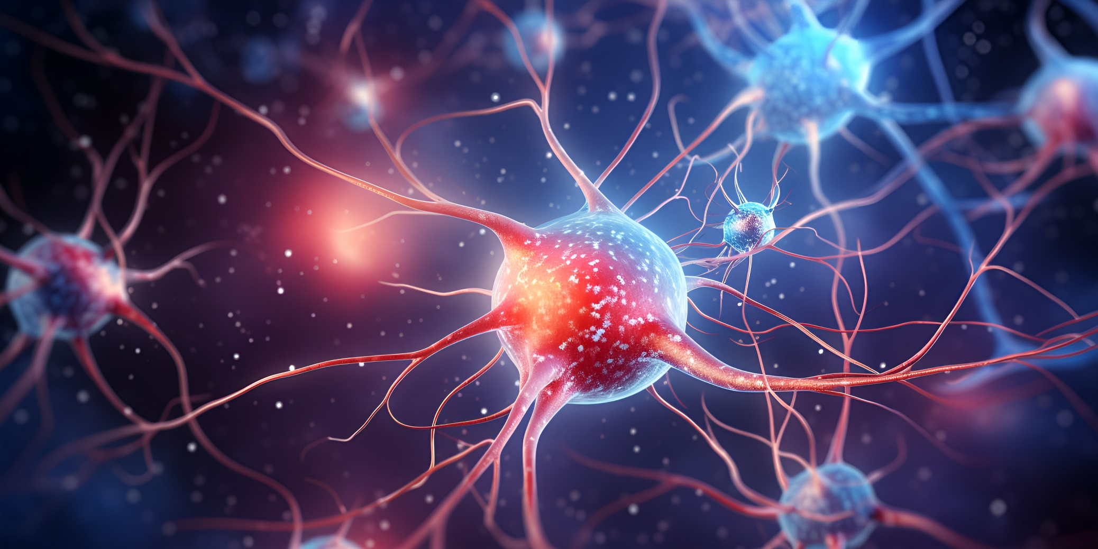

Slide 14
Brief Review of Topics Related to Artificial Intelligence - History -Continued
2011-2020s
DEEP Learning
employs huge neural networks with many layers of processing units
use advances in computing power and improved training techniques to learn complex patterns on large amounts of data
Common applications include image and speech recognition.
Present–
Generative AI - all of the major companies are developing Generative AI as possible rate—Microsoft, Google, Chabot ++

Slide 15
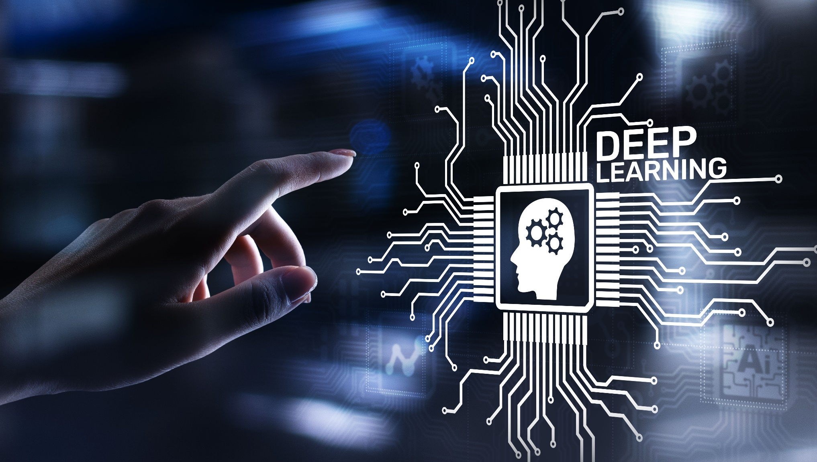

Slide 17
So, What do You Think?

Slide 18
Brief Review of Topics Related to Artificial Intelligence
What is Information? How do we measure it etc. How fast can it be transmitted (communicated) in a noisy environment and maintain an acceptable number of errors etc.
EXAMPLE: If the 2 letters CA? are known what is BEST guess for the next letter?
Those used in the words: “CAB, CAD, CAM ,CAN ,CAP ,CAR ,and CAT” all seem reasonable.
Actually the BEST Guess would be the Letter E, since it is the most probable letter in the English Alphabet but in this case it is WRONG!. Since there are NO Possible ways to determine the BEST letter etc., statistical and probability methods must be used..
Great Mathematicians, Scientists, and Engineers have studied and struggled with the Information/Noise problem for centuries:
Examples: Hartley and Nyquist (Bell Labs)
’Markoff Chains (Sequences of related events and characters) ’
‘Cybernetics’ (Norman Weiner- the Yellow Peril),
The’ Ergodic’ Hypothesis
All are the characteristic of Noise measured on many similar devices at one time equivalent, to the measurement from a single unit over a long time (infinity)?
IT is related to Boltzmann’s Statistical Mechanics
involved with Uncertainty. Thermodynamics is also a section. Information is associated with known events or messages and measured in BITS.
A 2 sided coin Flip is one Bit.
A 2 sided coin with both sides Heads or Tails is Zero Bits No Information.
Shannon determined the amount of ‘information’ (Lower Case) in the English Language based on the Probability of Occurrence of each letter in various texts. The result is the Entropy since it is the average information relative all possible outcomes.

Slide 19
Brief Review of Topics Related to Artificial Intelligence
‘IT’ Continued
EXAMPLE of LOG Base 2:
2^2=4 2^3=8 2^4= 16
2^?= Logs 2 (?)
2^(4.7) = 26
. To determine a specific letter of the 26 Letters in the Alphabet,, requires less than 5 questions (32 choices), but more than 4 Bits (16 choices).
.In general, the most efficient method to finding “answers” is to divide the .number of Characters etc. BY HALF.
Definition of ENTROPY-.’S’.
S= k LOG(W)
Where ‘ k’ is the number of States (Letters etc)
W is the Probability of the message
‘ ‘ LOG’ is the Logarithm to the Base 2 (For Digital/ Binary systems) , W is the number of possible choices, and is measured in BITS.
The Videos to be shown compare the Information contained in several interesting cases-Deck of Cards, Pair of Dice etc
Page 7.

Slide 20
References
KAHN Videos:
Artificial Intelligence:
How does AI Work?
What is Machine Learning?
How do Neural Networks work?
Information Technology:
Into to Channel Capacity
Measuring Information
Information Entropy
University of Pennsylvania POD cast on the use of BOTS for college level papers.
The Information –James Gleick (Book)
YOUTUBE Videos

Slide 21
Future Meetings
We are in a CRITICAL need for others to give presentations—please contact us for help in preparation etc.
Thank you again to everyone who has given talks previously.
Jack Yurasek (201-337-4433) Email--Jyurasek@aol.com
Harry Bennett (201-803-1475) Email-harrbenn7@gmail.com
Marc Bernhardt (201-693-3997)
Notes:
21

